Slide 1
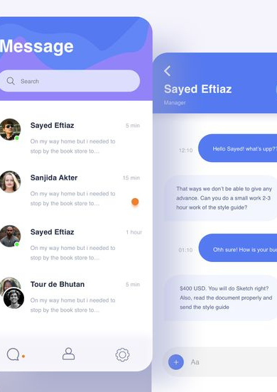
WHISP: REAL TIME JAVA CHAT WITH GUI
SHAURYA SRINET (RA2111032010006)

Slide 2
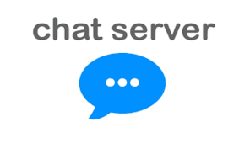
INTRODUCTION
In our digital age, seamless and secure interactions are vital. Behind every chat application is a sophisticated computer network ensuring timely and reliable conversations. This project centers on developing a chat server—a hub of real-time digital dialogues. Using advanced technologies like C++ and WebSocket, we aim to understand the intricacies of building a robust, secure, and scalable chat server. J We will explore the challenges and solutions inherent in crafting this pivotal component of modern communication.

Slide 3
METHODOLOGY
1. Requirement Analysis:
Purpose: Understand the features and constraints for the chat server.
Tasks: List out functionalities (e.g., private messaging, group chat, file sharing).
2. Tool & Libraries Selection:
Socket Programming: C++ doesn't have a built-in library for socket programming, so use libraries like WinSock for Windows or sys/socket.h for UNIX/Linux.
Threading: To handle multiple clients, utilize threading libraries like <thread> or POSIX threads (<pthread.h>).
Data Handling: Decide on data structures and libraries for handling messages and storing chat logs (e.g., STL containers).

Slide 4
3. System Architecture Design:
Client-Server Model: Design a central server that clients connect to.
Multi-threading: Each client connection should spawn a separate thread or process.
Protocol Design: Define a simple communication protocol for message types (e.g., CONNECT, MESSAGE, DISCONNECT).
4. Server Implementation:
Socket Initialization: Create, bind, and listen on a server socket.
Client Handling: Accept client connections and spawn threads for each.
Message Handling: Receive messages from clients, process, and relay messages as required.

Slide 5
5. Client Implementation:
Socket Initialization: Create a socket and establish a connection to the server.
User Interface: Develop a simple CLI (Command-Line Interface) or GUI (if desired) for users to send and receive messages.
Message Handling: Send messages to the server and display received messages from other clients.
6. Security Measures:
Encryption: Implement basic encryption (like TLS) if libraries or tools are available.
Authentication: Introduce a simple username-password system or token-based authentication for user identification.

Slide 6
7. Testing:
Functional Testing: Ensure all features (e.g., messaging, group chats) work as expected.
Load Testing: Check the server's performance with many clients connected simultaneously.
Security Testing: Ensure that communications are secure and there are no vulnerabilities.
8. Documentation & Comments:
Code Documentation: Write clear comments for each major block of code.
User Guide: Create a guide with instructions on how to run the server and client applications.

Slide 7
9. Deployment & Monitoring:
Deployment: Set up the server on a dedicated machine or cloud instance.
Monitoring: Monitor server performance and handle any exceptions or crashes.
10. Feedback & Iteration:
Feedback Collection: Get feedback from initial users.
Improvements: Implement additional features or fixes based on feedback.

Slide 8
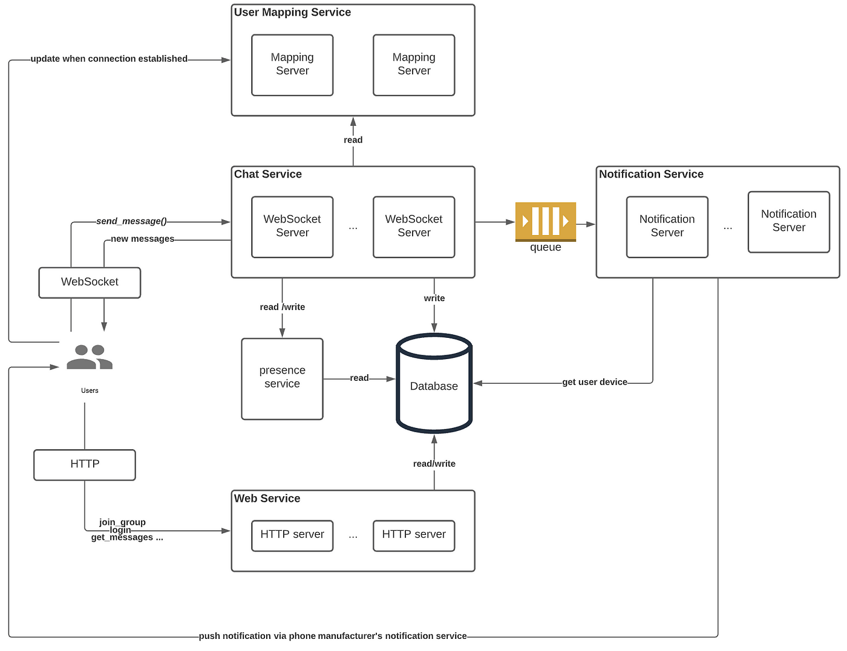
ARCHITECURE

Slide 9

USE CASES
1
Private Mesaging between users
4
File sharing in chat
2
Message Encryption
5
Message History Retrieval
3
Group Chat Creation and Mesaging

Slide 10
INNOVATIONS
Multi-path Transmission:
Utilize multiple paths in a network to send chat messages, optimizing for faster delivery and fault tolerance. If one path becomes unavailable, the chat system automatically switches to another.
Software-defined Networking (SDN) for Chat Prioritization:
Use SDN to prioritize chat traffic in a network, ensuring real-time messages get preference over other types of traffic.
Zero Trust Network Model:
Implement a zero-trust model, where every request to the chat server is treated as untrusted regardless of its origin. This enhances security by ensuring continuous authentication and authorization.

Slide 11
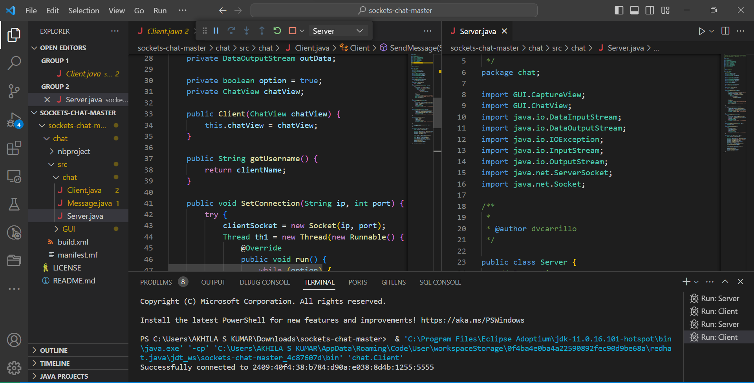
CODE

Slide 12
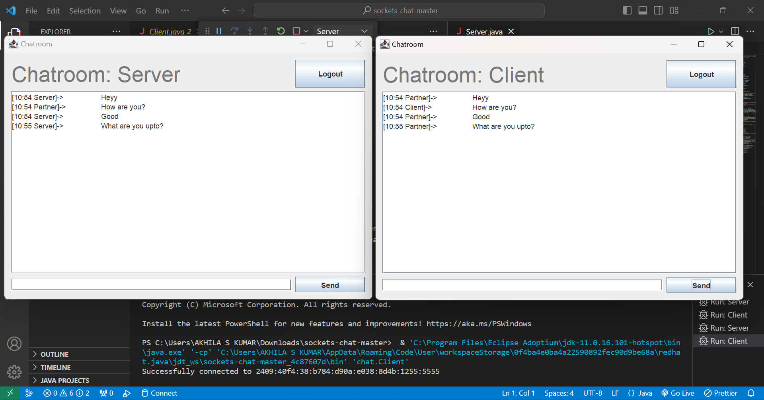
IMPLEMENTATION

Slide 13
THANK YOU!

